Slide 1
6.172 Final Presentation
yiannig-rdelaus-cburnett

Slide 2
Serial Optimizations

Slide 3
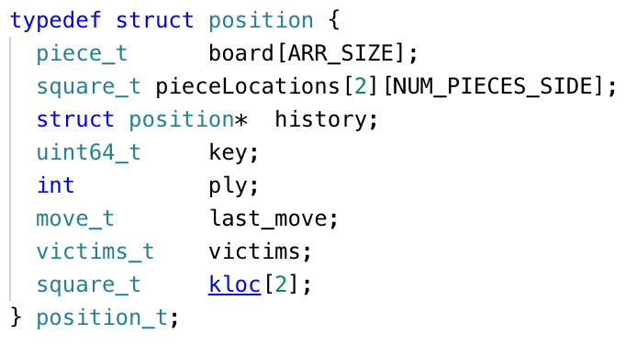
Board Representation
ARR_WIDTH → 10
Square_t → int16
Piece_t → uint8
rnk_t, fil_t → int8

Slide 4
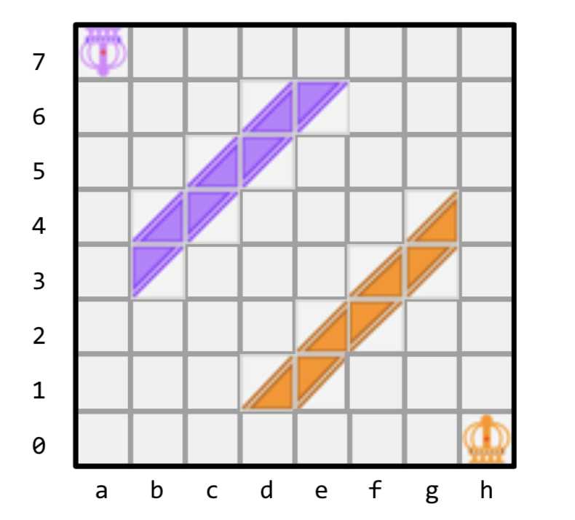
Board Representation: pieceLocations
pieceLocations[2][8] =
[h0, g4, f3, g3, e2, f2, d1, e1]
[a7, d6, e6, c5, d5, b4, c4, b3]

Slide 5
Board Representation: Piece_t
0
1
1
1
0
1
1
0
Index into pieceLocations
Color
Type
Orientation

Slide 6
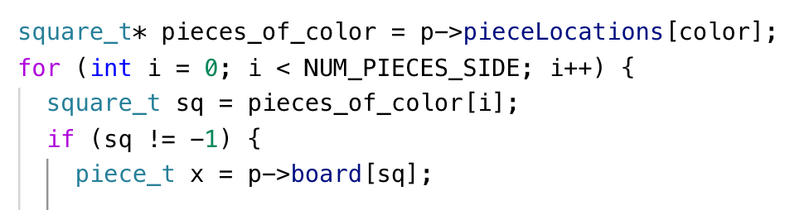
eval
Utilized new board rep by only looping over pieces instead of entire board

Slide 7
generate_all
Similar to eval, also modified loop to iterate over pieces

Slide 8
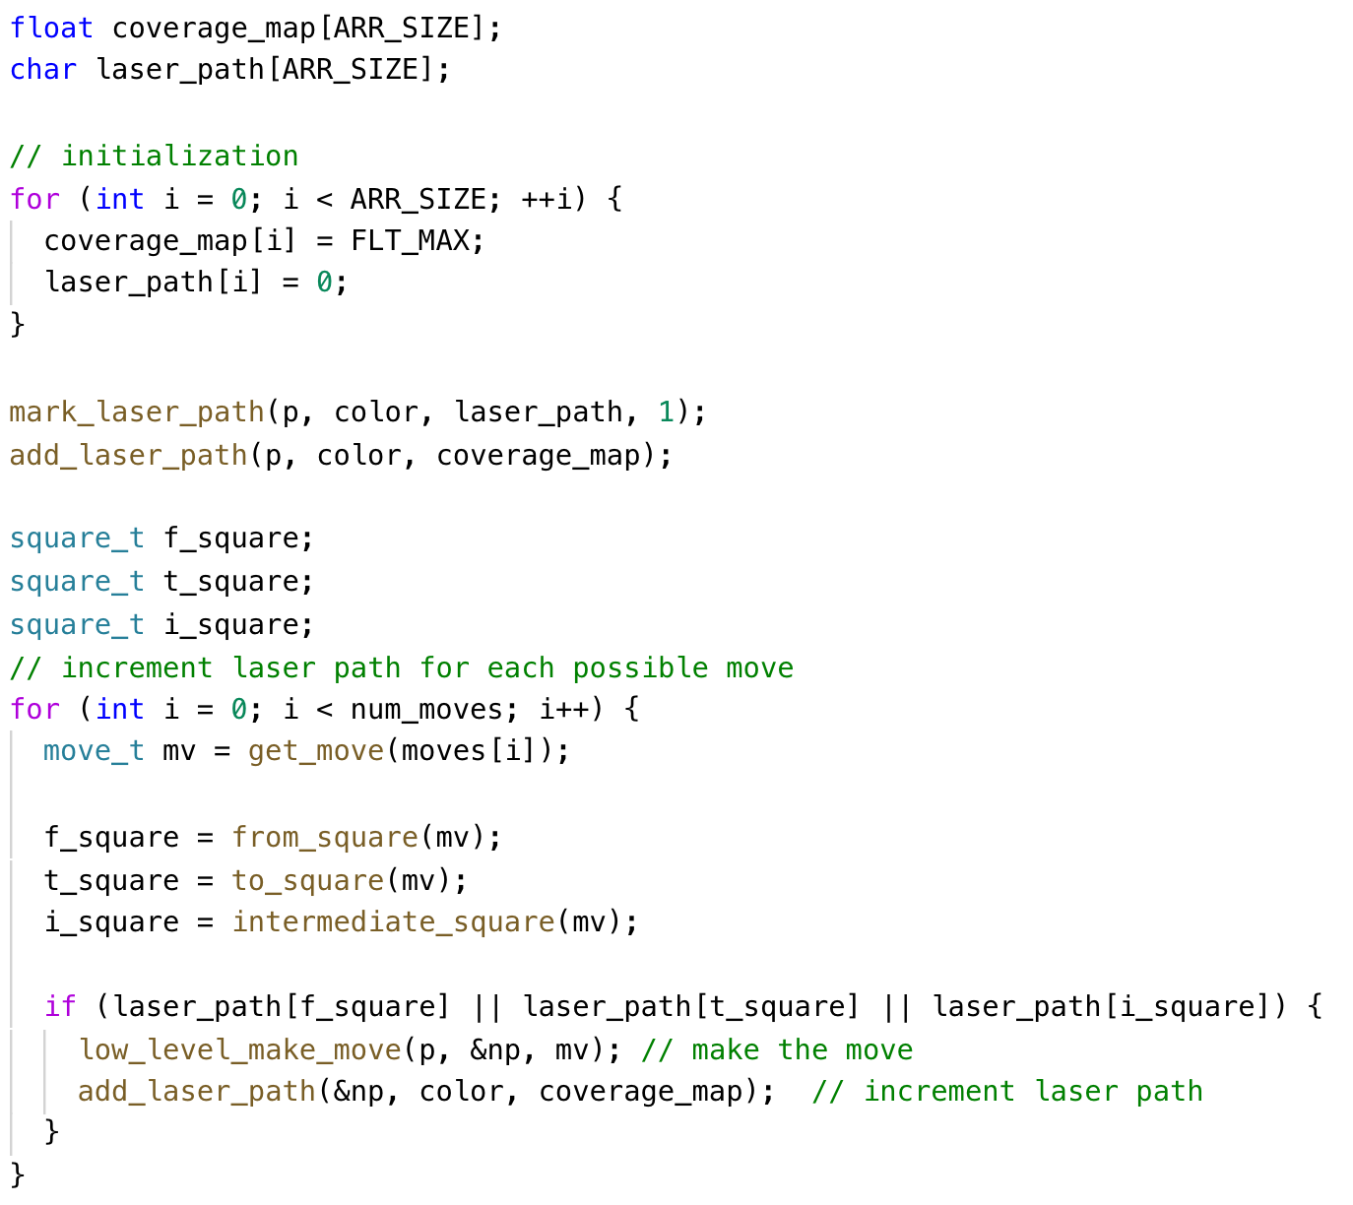
laser_coverage
3 Main Changes:
1. Reduced calls to low_level_make_move and add_laser_path by first checking laser path modified

Slide 9
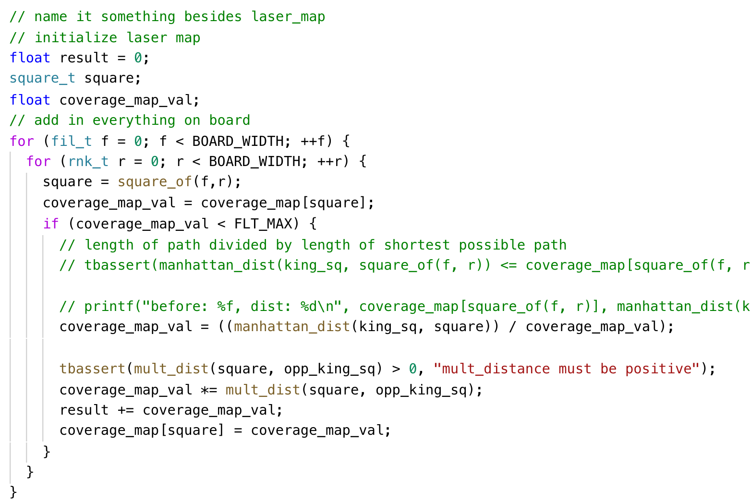
laser_coverage
3 Main Changes:
2. Reduced calls to square_of

Slide 10
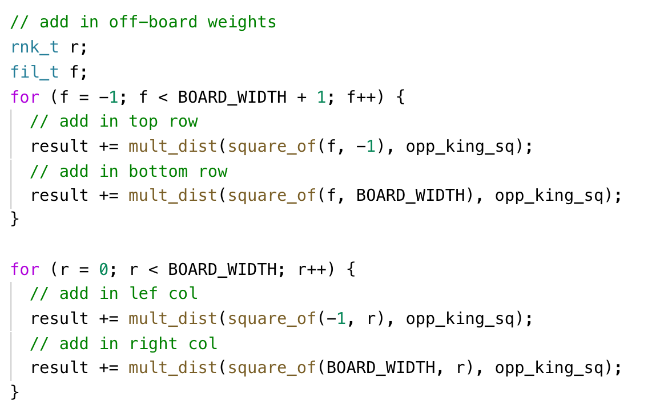
laser_coverage
3 Main Changes:
3. Combined loops to reduce overhead

Slide 11
laser_coverage
3 Main Changes:
3. Combined loops to reduce overhead
3 changes yielded significant speed up (approx. 70 ELO against reference)

Slide 12
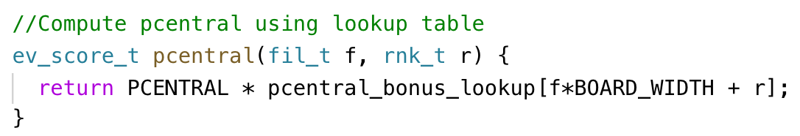
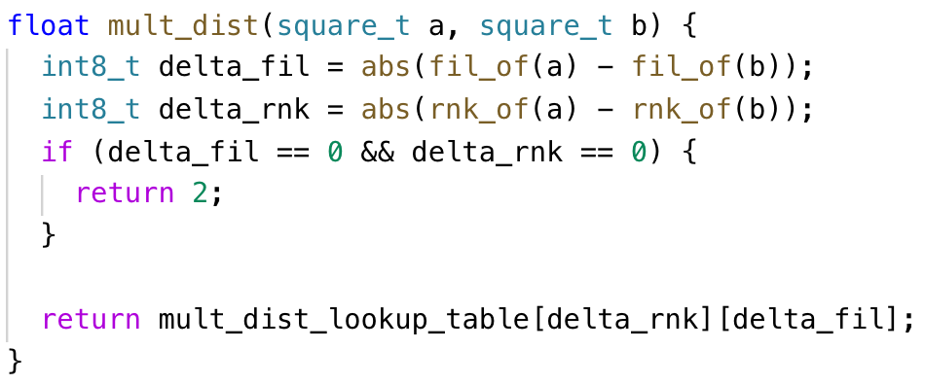
Lookup Tables
pcentral — store precomputed bonuses for pawns near the center of the board
Avoids 2 branches and 2 sqrt calls
mult_dist — same idea, store distances in a 10x10 lookup table
Provided little to no performance increase

Slide 13
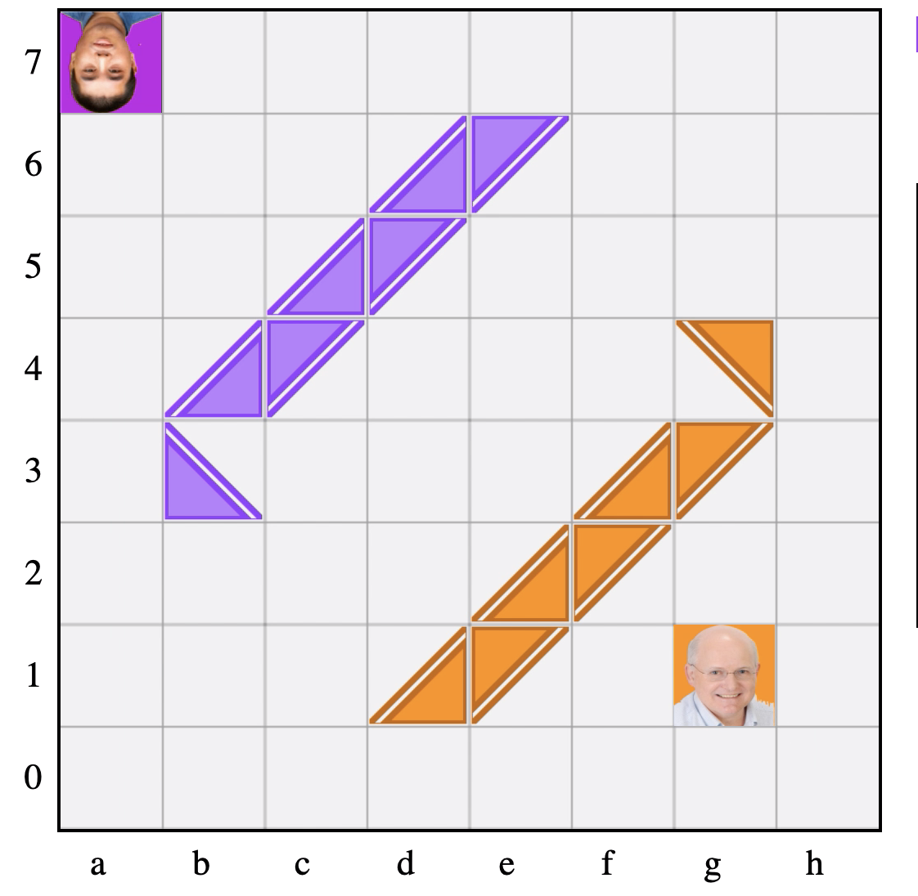
Mobility heuristic
Encourages king to find a safe space where opponent’s laser doesn’t pass thru neighboring square
Added significantly to in-game performance (approx 135 ELO against reference)

Slide 14
Opening Book
Move Generation and Scoring
Take top N moves
Series of Moves
Sort Moves
Find best move from series of moves

Slide 15
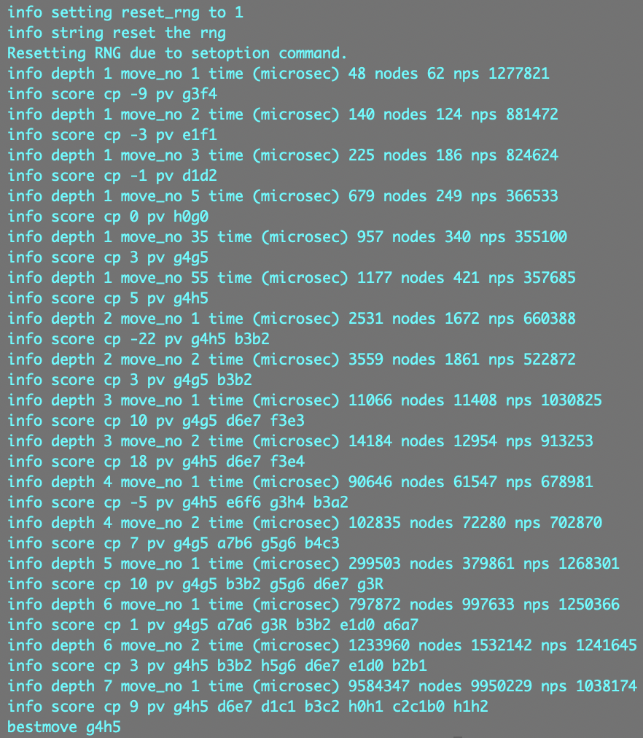
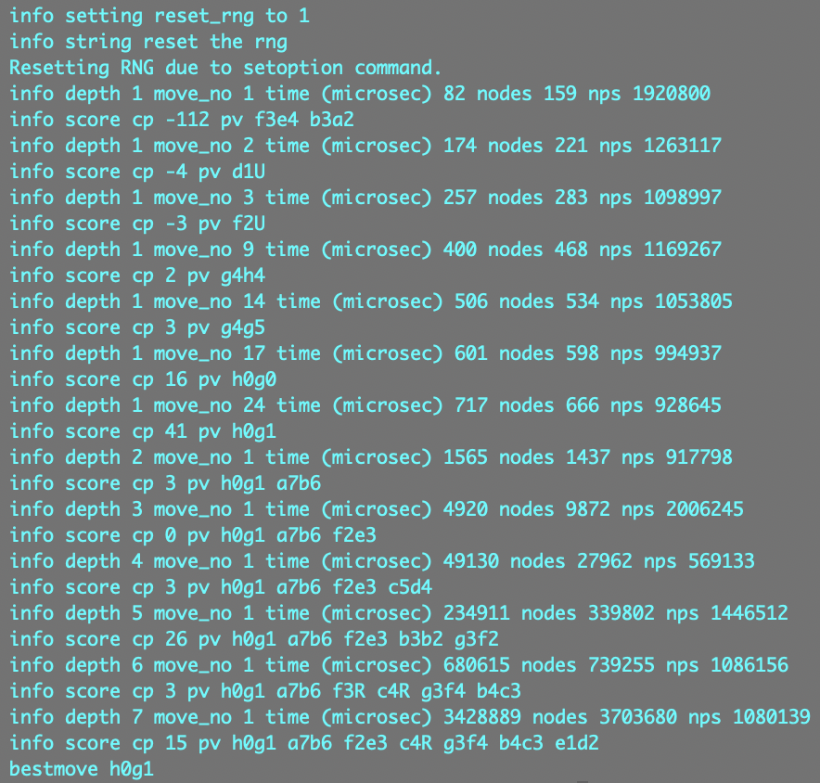

Slide 16
Parallel Optimizations

Slide 17
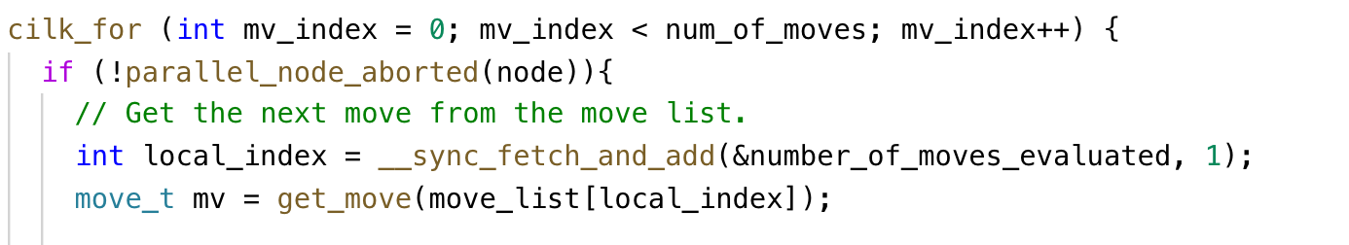
Scout Search
scout_search seemed to easiest to modify
Decided to parallelize move loop
Required:
Locking on node
Locking on transposition table
Atomic incrementation of node_count_serial

Slide 18
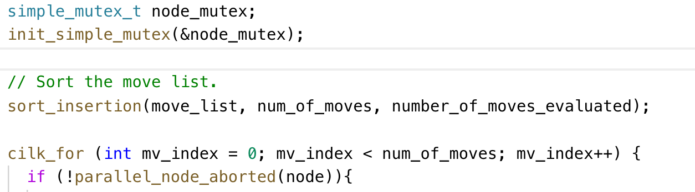
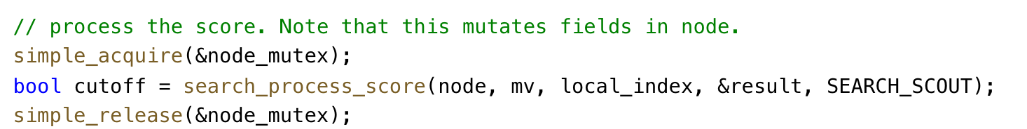
Scout Search
Changes:
Locking on node

Slide 19
Scout Search
Changes:
Locking on transposition table
Indirect recursion- call to search_scout is made inside evaluate_move

Slide 20
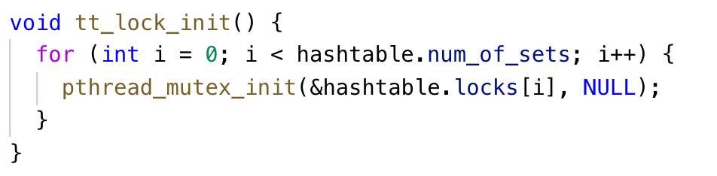
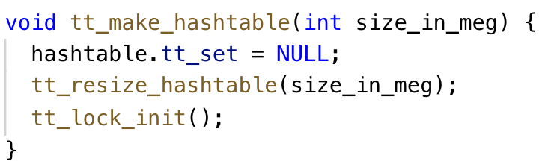
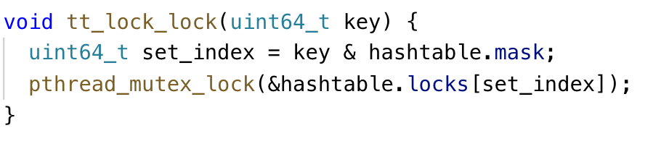
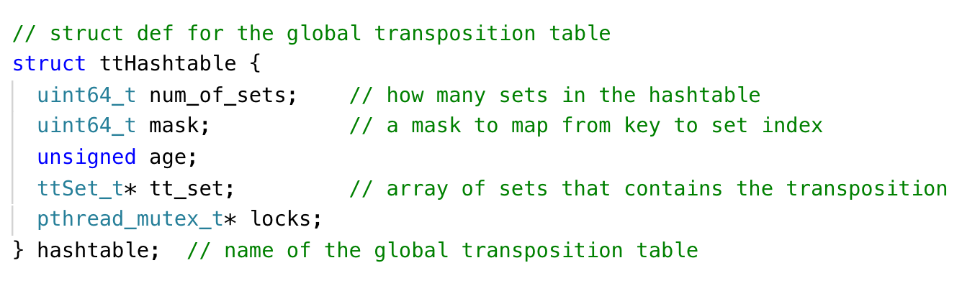
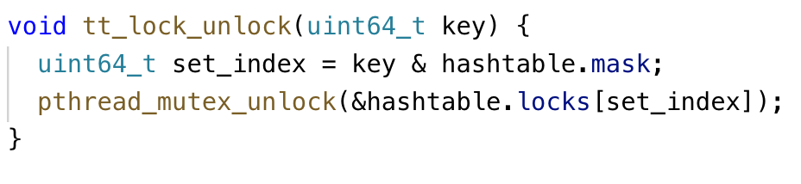
Scout Search - Modify tt.c
Changes:
Locking on transposition table
Indirect recursion- call to search_scout is made inside evaluate_move

Slide 21
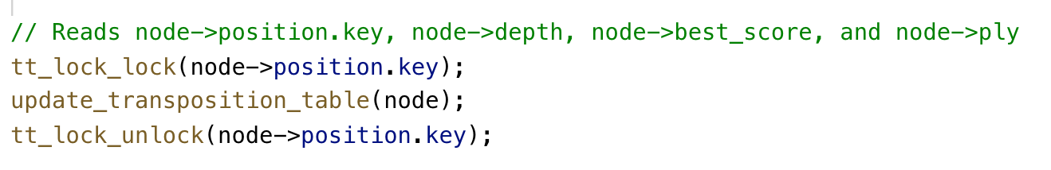
Scout Search - Lock on transposition table
Changes:
Locking on transposition table
Indirect recursion- call to search_scout is made inside evaluate_move
Lock OUTSIDE loop

Slide 22
Scout Search
Changes:
Locking on node
Node is called in parallel inside cilk_for

Slide 23
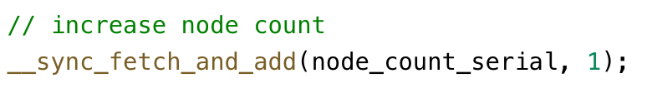
Scout Search
Changes:
Atomic incrementation of node_count_serial

Slide 24
Work Breakdown

Slide 25
Work Breakdown
Robert C. DeLaus (working at Optiver)
Open Book
Board Rep
Parallelization (scout_search)
Cameron Burnett (still searching, rejected from BCG, final round)
Table optimizations
Laser Coverage optimization
Exploratory serial optimizations (combining heuristic calculations)
Yianni Giannaris (not searching, rejected from BCG, first round)
Laser Coverage optimization
Exploratory serial optimizations
Exploratory parallel optimizations (parallelizing searchRoot)

